Slide 1
Welcome To York Code Dojo
David Betteridge @da_betteridge
Yorkdevelopers.org
@yorkdevelopers
@yorkcodedojo

Slide 2
Agenda
Quick Introduction
Explain the problem
Work in pairs till 8.45pm
Opportunity to show off solutions
Pub about 9pm

Slide 3
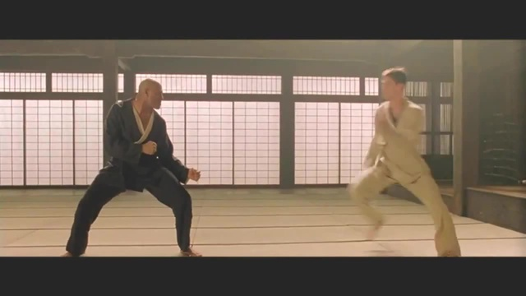
Code Dojo
Notes:
Aim for tonight isn’t to get a job, but to learn something news.
Who has been to a code dojo before?
What is the point?
It’s a place to practice coding safely. By that we mean it doesn’t matter if you haven’t solved the problem by the end of the evening. No one will judge you on it. It’s a place to practice, learn and try out new things.
For example you could use a language you have never used before, partner with someone new, try a different approach to solving the problem. You could add your own constraints; like my functions won’t have more than three lines; or I’m not going to use any IF statements.
(It’s also meant to be fun) It’s driving a car to work every day, you might cover a lot of miles, but if you are doing the same journey then does your driving ability really improve?
It’s driving a car to work every day, you might cover a lot of miles, but if you are doing the same journey then does your driving ability really improve?

Slide 4
Tonight – Interview Questions
These are classic questions rather than good ones!
Notes:
I expect you all have different views on what makes a good question.
These are some classic ones from the internet, and a few I’ve made up!
How many of you are students?
Who has applied for job recently?

Slide 5
Tonight – Interview Questions
Work on the problems in your group
Interview other groups
Notes:
From want of a better plan….
Spend about an hour working through the problems in your group.
And then we will pair up the groups to interview one another.
Printouts plus on git.

Slide 6
Useful Things
Wi-fi Password
YSJ Guest
Agencycord11
Git Hub Address
https://github.com/YorkCodeDojo/InterviewQuestions

Slide 7
York Developers
Games Developers (3rd Thursday of the month)
Code and Coffee (Monday and Wednesday mornings)
Agile York (3rd Wednesday of the month)
Dot Net York

